Slide 1
Formation and growth of Clusters and its galaxies I:
Cosmic Growth of BCGs (and their Globular Cluster population)
Jeremy Lim (University of Hong Kong)
Youichi Ohyama (ASIAA, Taiwan)
Thomas Broadhurst (Ikerbasque, Spain)
Emily Wong (Research Assistant)
Juno Lee (MPhil, HKU)
Rex Lam (UCLA, USA)
Bryan Zhang (HKU)
Lilian Lee (HKU)
Michael Leung (HKU)
Florence Tsang (HKU)
Andrew Wei (High school)
BCG Perseus cluster (red = Hα, blue = “young” stars)
RGC grant: 17303414

Slide 2
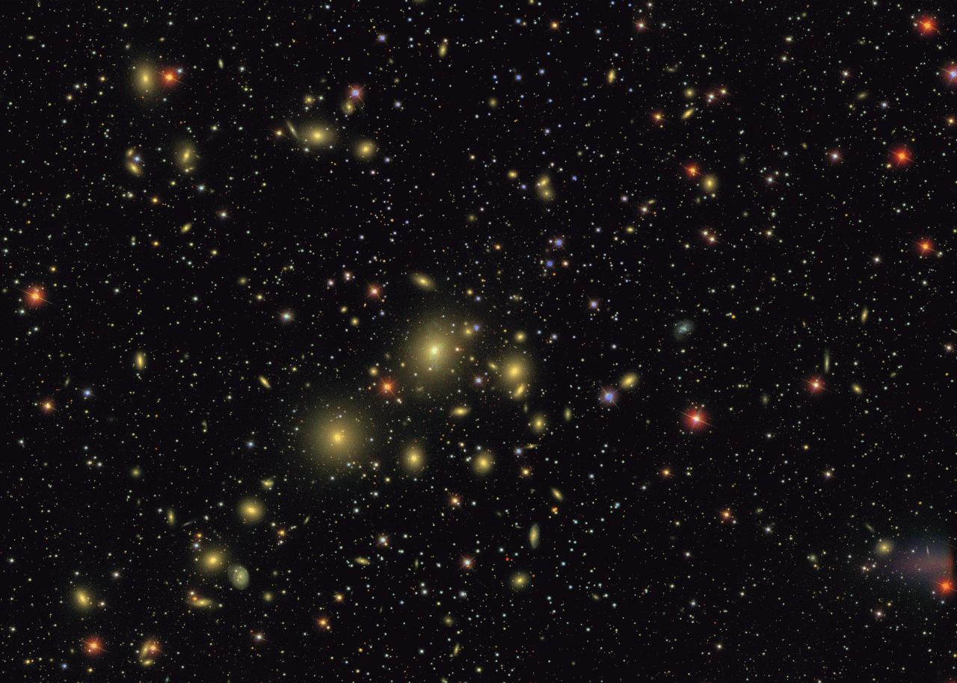
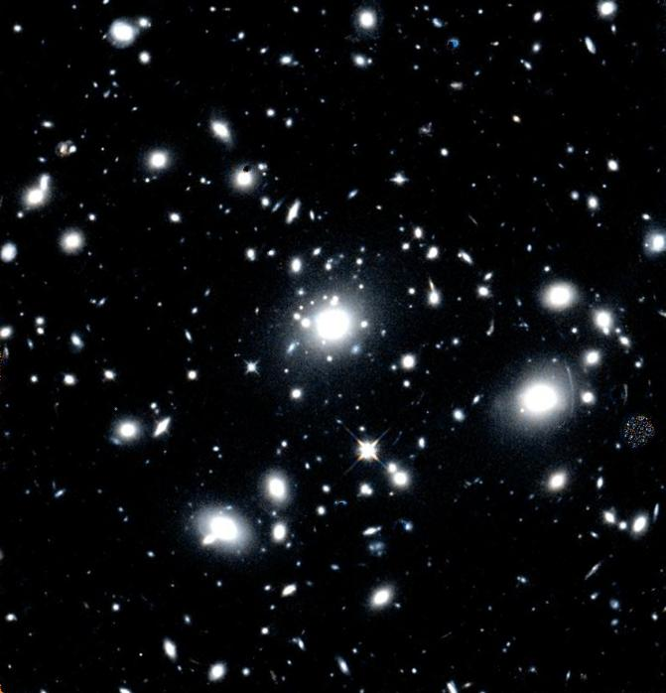
Cosmic Growth of BCGs
BCGs are largest, most luminous, most massive galaxies in Universe
Enormous sizes + large masses pose particular strong challenge for models of galaxy growth
Perseus cluster
MACS J0329.6-0211
(z=0.018)
(z=0.45)
Notes:
The MAssive Cluster Survey (MACS) is an ongoing project aimed at the compilation and characterization of a statistically complete sample of very X-ray luminous (and thus, by inference, massive), distant clusters of galaxies. The primary goal of MACS was to increase the number of known massive clusters at z > 0.3 from a handful to a hundred. The final MACS cluster sample has greatly improved our ability to study quantitatively the physical and cosmological parameters driving cluster evolution at redshifts and luminosities poorly sampled by all previous cluster surveys.
Z = 0.45 corresponds to lookback time of ~5 Gyr

Slide 3
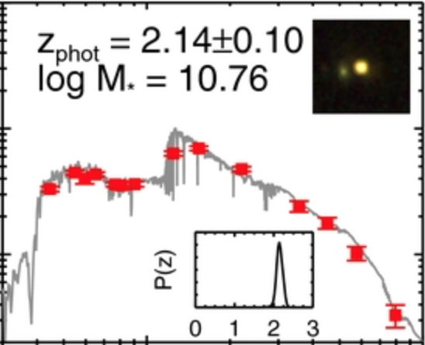
Cosmic Growth of BCGs
BCGs are largest, most luminous, most massive galaxies in Universe
Enormous sizes + large masses pose particular strong challenge for models of galaxy growth
Proposed progenitors: massive quiescent galaxies (“red nuggets”) at z ~ 2 (~10 Gyr ago) having ~⅕ R_{e} and ~½ M* of local BCGs
100
Newman+12
Red nuggets have stellar masses M* ≈ 10¹¹ M and R_{e} ≈ 1 kpc.
10
1
1
10

Slide 4
Cosmic Growth of BCGs
Mergers with cool-gas-poor galaxies (dry mergers) - add stars predominantly to outskirts, hence substantial growth in size (R_{e} ∝ M ^{>1} for minor mergers, R_{e} ∝ M for major mergers) - modest/substantial growth in mass for minor/major mergers
Bédorf+13
Notes:
R_{e} ∝ M ² in simulations by Naab et al. 2009
Minor mergers: 1/10th primary mass

Slide 5
Cosmic Growth of BCGs
Mergers with cool-gas-poor galaxies (dry mergers) - add stars predominantly to outskirts, hence substantial growth in size (R_{e} ∝ M ^{>1} for minor mergers, R_{e} ∝ M for major mergers) - modest/substantial growth in mass for minor/major mergers
Bédorf+13
Notes:
R_{e} ∝ M ² in simulations by Naab et al. 2009

Slide 6
Cosmic Growth of BCGs
Mergers with cool-gas-poor galaxies (dry mergers) - add stars predominantly to outskirts, hence substantial growth in size (R_{e} ∝ M ^{>1} for minor mergers, R_{e} ∝ M for major mergers) - modest/substantial growth in mass for minor/major mergers
Mergers with cool-gas-rich galaxies (wet mergers) - adds pre-existing stars to outskirts - cool gas accumulates around center and fuel star formation, galaxy shrinks in response to deeper central potential - modest/substantial growth in mass for minor/major mergers
Star formation from cooled intracluster gas (“X-ray cooling flow”) - effect on galaxy size depends on star-formation rate over time and whether/where star clusters disrupted - effect on galaxy mass depends on star-formation rate over time
Notes:
R_{e} ∝ M ² in simulations by Naab et al. 2009

Slide 7
Cosmic Growth of BCGs
Conventional view of BCGs: - passive stellar evolution since z ≳ 2 (≳10 Gyr ago) (e.g., Wen & Han 11) - dry minor mergers (hierarchical merging) primarily responsible for growth (White 76, Ostriker & Hausman 77)
r’ (7840 Å), z’ (8930 Å) rest-frame optical at z ≤ 1.
Wen&Han11

Slide 8
Cosmic Growth of BCGs
Evidence in conflict with conventional view: - excess rest-frame UV continuum indicating recent star formation (e.g., Wen & Han 11) - estimated minor merger rates too low based on observations of companions to massive galaxies at z ~ 1−3 (Newman+12)
r’ (7840 Å), z’ (8930 Å) rest-frame optical at z ≤ 1.
Wen&Han11

Slide 9
Cosmic Growth of BCGs
Evidence in conflict with conventional view: - excess rest-frame UV continuum indicating recent star formation (e.g., Wen & Han 11) - estimated minor merger rates too low based on observations of companions to massive galaxies at z ~ 1−3 (Newman+12)
r’ (7840 Å), z’ (8930 Å) rest-frame optical at z ≤ 1.
g’ (4860 Å) rest-frame UV at z > 0.2
Wen&Han11

Slide 10
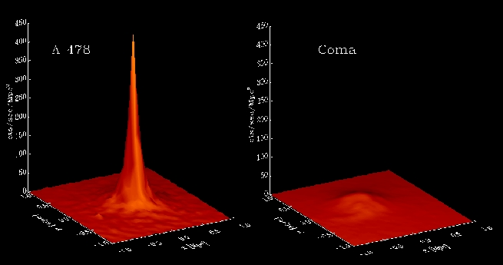
Gas and Star Formation in BCGs
BCGs in cool-core (relaxed) clusters preferentially exhibit: - luminous optical emission-line nebulae (Heckman+89; Liu+12; Tremblay+15), peculiar integrated spectra more similar to LINERs than HII regions (Heckman+89; Ferland+09) - excess-blue and/or UV continuum tracing star formation (McNamara&O’Connell89; Rafferty+08; Donahue+10)
cool-core cluster
non-cool-core cluster

Slide 11
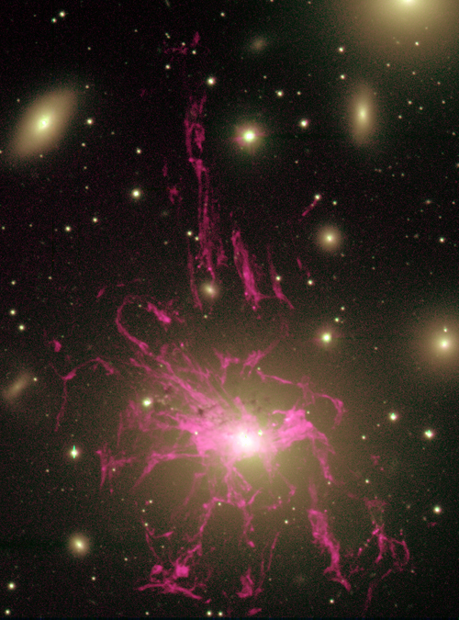
Gas and Star Formation in BCGs
Multi-phase gas: ionized + atomic + molecular
Perseus BCG
Hα + [NII]
30˝
(10.8 kpc)
Nebular X-ray gas comprise intracluster X-ray gas that penetrates into and energizes cooler nebular gas (Fabian11)?
Fabian+06
Conselice+01

Slide 12
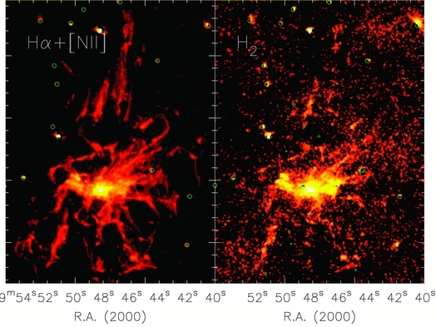
Gas and Star Formation in BCGs
Multi-phase gas: ionized + atomic + molecular
Perseus BCG
Hα + [NII]
30˝
(10.8 kpc)
H₂ (2.12 um)
Conselice+01
Lim+12

Slide 13
Gas and Star Formation in BCGs
Multi-phase gas: ionized + atomic + molecular
Perseus BCG
Hα + [NII]
Galactic L_{CO}-M(H₂) gives ~10¹⁰ M
30˝
(10.8 kpc)
CO(2-1)
H₂ (2.12 um)
Salomé+06
Conselice+01
Lim+12

Slide 14
Gas and Star Formation in BCGs
Multi-phase gas: ionized + atomic + molecular
Perseus BCG
Hα + [NII]
30˝
(10.8 kpc)
CO(2-1)
10˝
(3.6 kpc)
Ho+09
Conselice+01
Lim+12

Slide 15
Gas and Star Formation in BCGs
Multi-phase gas: ionized + atomic + molecular
Perseus BCG
Hα + [NII]
30˝
(10.8 kpc)
Filament masses assuming Galactic L_{CO}-M(H₂) conversion
CO(2-1)
H₂ (2.12 um)
3×10⁸ M
10˝
(3.6 kpc)
2×10⁹ M
5×10⁸ M
1×10⁹ M
Ho+09
Conselice+01
Lim+12

Slide 16
Gas and Star Formation in BCGs
(Many) star clusters associated with but not coincident with nebular gas
Perseus BCG
Hα + [NII]
30˝
(10.8 kpc)
Filament masses assuming Galactic L_{CO}-M(H₂) conversion
B band
CO(2-1)
H₂ (2.12 um)
3×10⁸ M
10˝
(3.6 kpc)
2×10⁹ M
5×10⁸ M
1×10⁹ M
Ho+09
Conselice+01
Lim+12

Slide 17
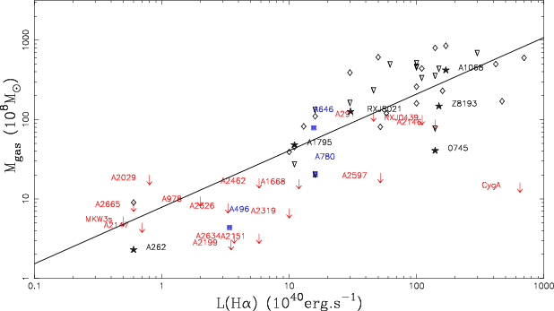
Gas and Star Formation in BCGs
BCGs in cool-core clusters preferentially exhibit luminous H₂ (Edge+03) and CO (Edge+01; Salomé & Combes 2003)
CO luminosities BCGs rival local ULIRGs
Salomé+03

Slide 18
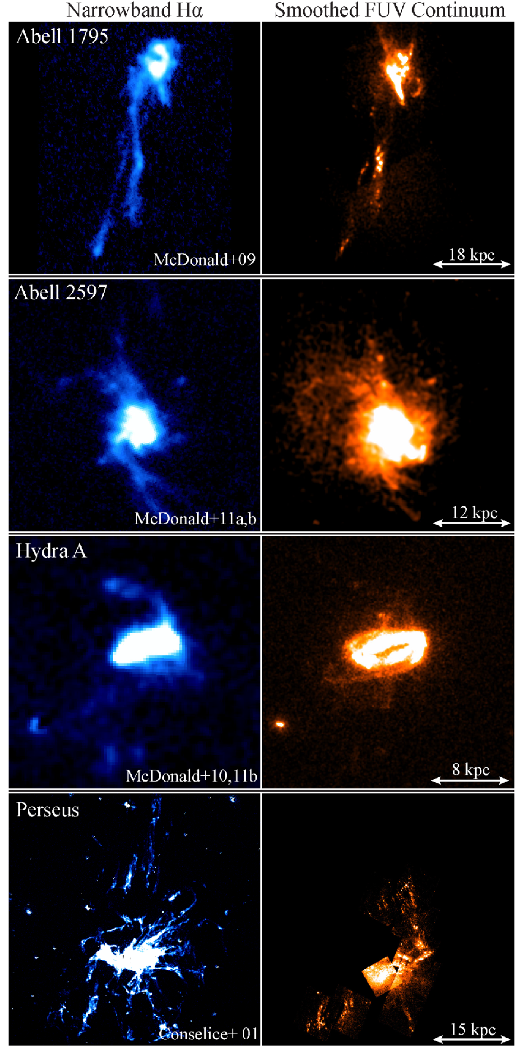
Gas and Star Formation in BCGs
Star formation: - spatially-resolved UV continuum images resemble but not necessarily coincident with optical-line-emitting gas
Tremblay+15
(z=0.055)
(z=0.062)
(z=0.082)
(z=0.018)

Slide 19
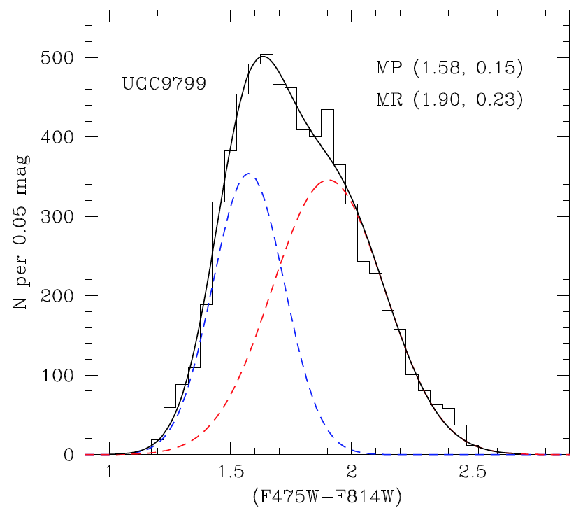
Gas and Star Formation in BCGs
Key questions: - nature of gas+star formation: major mergers or cooled intracluster gas? - contribution to BCG growth in size and mass, and population of globular clusters
BCG globular clusters: - number up to a few 10,000s - bimodal metallicity distribution centered at ~0.03 Z (metal-poor) and ~0.3 Z (metal-rich), but spanning broad range from ~0.004 Z to ~1.0 Z (Harris+17)
Metal-poor
Metal-rich
increasing metallicity
Notes:
The MAssive Cluster Survey (MACS) is an ongoing project aimed at the compilation and characterization of a statistically complete sample of very X-ray luminous (and thus, by inference, massive), distant clusters of galaxies. The primary goal of MACS was to increase the number of known massive clusters at z > 0.3 from a handful to a hundred. The final MACS cluster sample has greatly improved our ability to study quantitatively the physical and cosmological parameters driving cluster evolution at redshifts and luminosities poorly sampled by all previous cluster surveys.
Z = 0.45 corresponds to lookback time of ~5 Gyr

Slide 20
Gas and Star Formation in BCGs
Two case studies: - Perseus (local), individual star clusters - MACS J0329.6-0211 (~5 Gyr ago), spatially-resolved young stellar population
Perseus cluster
MACS J0329.6-0211
(z=0.018)
(z=0.45)
Notes:
The MAssive Cluster Survey (MACS) is an ongoing project aimed at the compilation and characterization of a statistically complete sample of very X-ray luminous (and thus, by inference, massive), distant clusters of galaxies. The primary goal of MACS was to increase the number of known massive clusters at z > 0.3 from a handful to a hundred. The final MACS cluster sample has greatly improved our ability to study quantitatively the physical and cosmological parameters driving cluster evolution at redshifts and luminosities poorly sampled by all previous cluster surveys.
Z = 0.45 corresponds to lookback time of ~5 Gyr

Slide 21
Many slides have been removed because the results not yet published

Slide 22
Summary
BCG younger star clusters/stellar population (can) span broad age range (~1-100s Myr): implicate formation from cooled intracluster gas rather than wet mergers
Contribution to BCG growth: - add (significantly?) to population of globular clusters - significant addition to BCG mass and/or size? - important for BCG growth at high z?
Insights to a potentially important mode of star formation at high-z

