Slide 1




The evolution of Massive Galaxy Clusters
Over the Past
10 Billion Years
Galaxy Clusters 2017
Santander, Spain – July 5, 2017
Michael McDonald
Massachusetts Institute of Technology
In collaboration with: The South Pole Telescope Collaboration, M. Bautz (MIT), E. Miller (MIT), A. Vikhlinin (CfA),
B. McNamara (UW), A. Edge (Durham), J. Hlavacek-Larrondo (UdM), and many others!

Slide 2
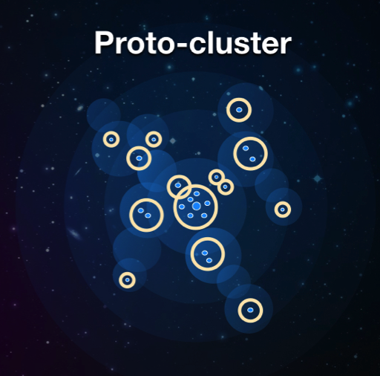
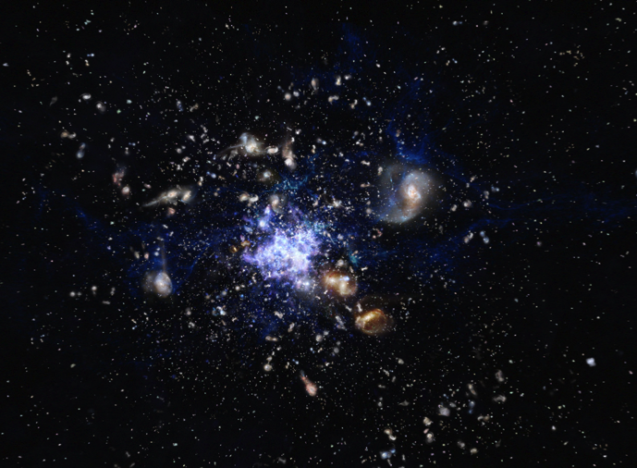
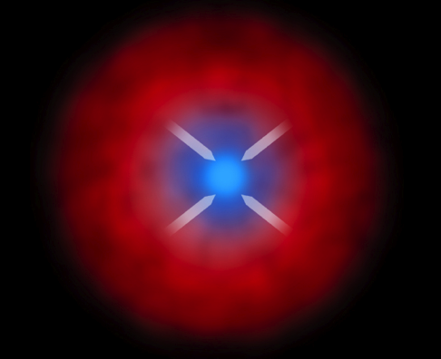
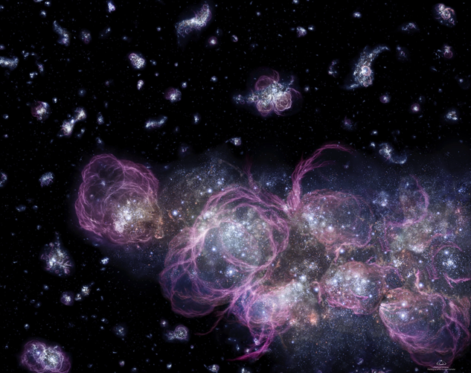
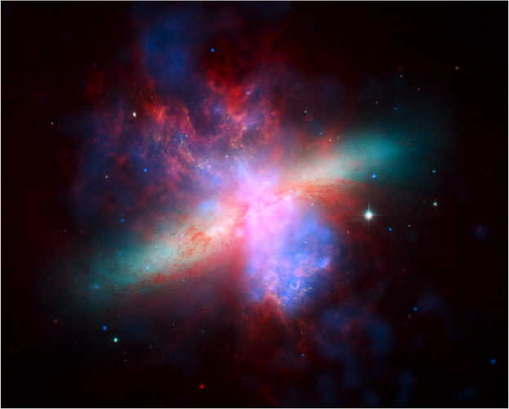
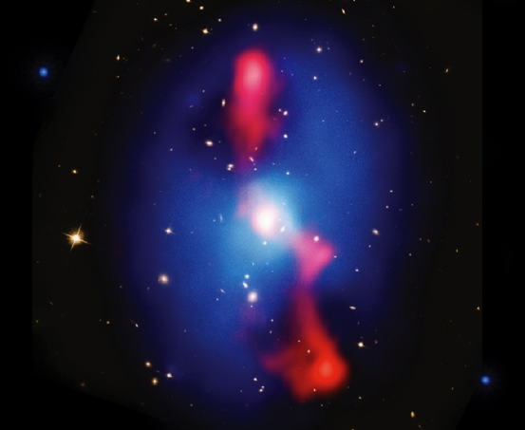
Timing of Major Milestones Remain Uncertain
BCGs Form
Cool Core Formation
z > 3
z ~ 2.5
z ~ 1.5
z ~ 3
z ~ 2
z ~ 1
ICM Established
Metal enrichment
AGN Feedback

Slide 3
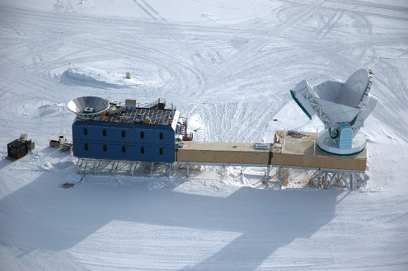
The SPT-Chandra Survey
2500 deg² survey
at 95, 150, 220 GHz
~1’ beam
Notes:
Nice thing about X-ray data is that you just “push a button” and the x-ray data is reduced (Julie)

Slide 4
The SPT-Chandra Survey
2500 deg² survey
at 95, 150, 220 GHz
~1’ beam
~500 clusters detected in SZ
0 < z < 1.85
Bleem et al (2015)
Notes:
Nice thing about X-ray data is that you just “push a button” and the x-ray data is reduced (Julie)

Slide 5
The SPT-Chandra Survey
2500 deg² survey
at 95, 150, 220 GHz
~1’ beam
~500 clusters detected in SZ
0 < z < 1.85
Bleem et al (2015)
~100 clusters followed up
w/ Chandra
McD+17
Notes:
Nice thing about X-ray data is that you just “push a button” and the x-ray data is reduced (Julie)

Slide 6
The SPT-Chandra Survey
2500 deg² survey
at 95, 150, 220 GHz
~1’ beam
~500 clusters detected in SZ
0 < z < 1.85
Bleem et al (2015)
~100 clusters followed up
w/ Chandra
McD+17
“SPT-Chandra” Survey
(McD+13,14,16,17)
Notes:
Nice thing about X-ray data is that you just “push a button” and the x-ray data is reduced (Julie)

Slide 7
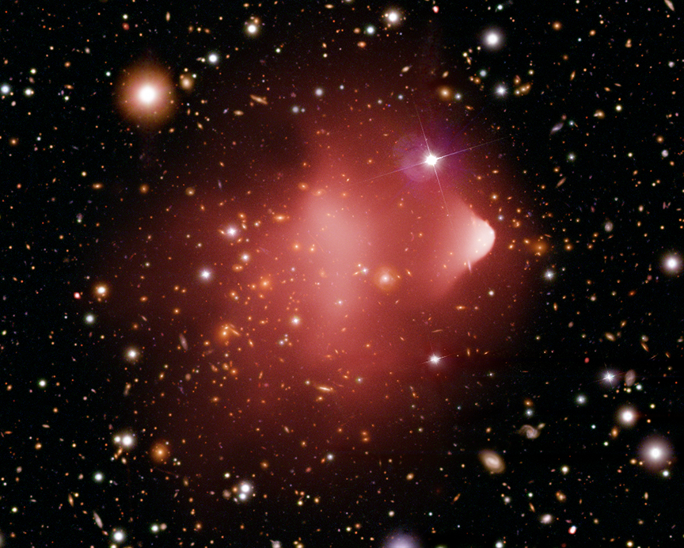
Results
Cooling Evolution
Morphological Evolution
Metallicity Evolution
BCG Growth/Evolution

Slide 8
Evolution of ICM Density Profiles
Consider redshift dependence of density at fixed radius
~100 clusters
Notes:
“Self-Similar”: In a purely matter universe, cluster collapse should be “scale free”. Assuming that initial perturbations don’t have a preferred scale, and that there are no additional physics that introduce preferred scales, clusters are scale-free.

Slide 9
Evolution of ICM Density Profiles
Consider redshift dependence of density at fixed radius
~100 clusters
n_{e}
+
+
+
+
+
+
+
+
+
+
+
+
E(z)
Notes:
“Self-Similar”: In a purely matter universe, cluster collapse should be “scale free”. Assuming that initial perturbations don’t have a preferred scale, and that there are no additional physics that introduce preferred scales, clusters are scale-free.

Slide 10
Evolution of ICM Density Profiles
Consider redshift dependence of density at fixed radius
Ask, how does redshift dependence vary with radius?
~100 clusters
n_{e}
+
+
+
n_{e}
+
+
+
+
+
+
+
+
+
+
+
+
+
+
+
+
+
+
+
+
+
E(z)
E(z)
n_{e}
+
+
+
n_{e}
+
+
+
+
+
+
+
+
+
+
+
+
+
+
+
+
+
+
+
+
+
E(z)
E(z)
Notes:
“Self-Similar”: In a purely matter universe, cluster collapse should be “scale free”. Assuming that initial perturbations don’t have a preferred scale, and that there are no additional physics that introduce preferred scales, clusters are scale-free.

Slide 11
Deviations from Self Similarity
McDonald+17
At large radii,
ICM density
profile is well-
described by
gravitational
collapse
At small radii,
no apparent
redshift
evolution in
gas density
  See also:
  McD+13,14
C=2; Self-Similar Expectation
C=0; No evolution
Central density “frozen in time”
Note: Similarity-breaking in temperature profile at r~0.2R₅₀₀
_{Vikhlinin+06, Baldi+12}
Notes:
“Self-Similar”: In a purely matter universe, cluster collapse should be “scale free”. Assuming that initial perturbations don’t have a preferred scale, and that there are no additional physics that introduce preferred scales, clusters are scale-free.

Slide 12
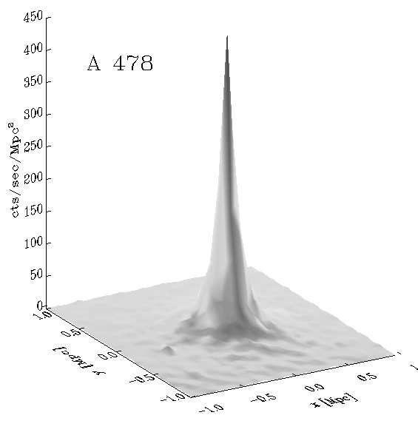
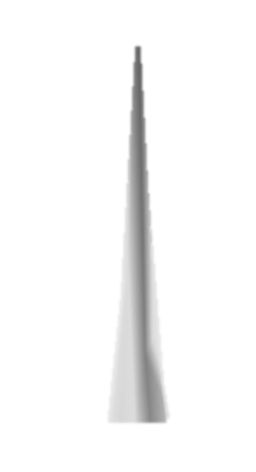
Cool Core (Non-)Evolution
Subtract the expected profile from gravitational collapse (SS)
  Excess is the “cool core”
No apparent change
in cool core shape,
size, density over
the past ~ 7 Gyr.
No Evolution
But the cooling time of this gas is ~1 Gyr!!!
McD+17

Slide 13
Cool Core (Non-)Evolution
Subtract the expected profile from gravitational collapse (SS)
  Excess is the “cool core”
No apparent change
in cool core shape,
size, density over
the past ~ 7 Gyr.
Mild evidence for
evolution at z > 1
Initial formation of
cores at z~1.5, followed
by long-standing,
gentle feedback
(e.g., Gaspari+14, Hogan+17)
McD+17

Slide 14
Cool Core Formation
Massive, dense cores formed early (z > 1)
  Bulk of cluster evolved self-similarly
  leads to increased contrast between core and bulk
Evidence for long-standing, gentle feedback!
McDonald+17
Also appears to be a maximum density that is not violated over full redshift range
  n_{e,max} ~ 0.1 cm⁻³
  May represent condensation point
  See also Voit+14

Slide 15
Results
Cooling Evolution
Morphological Evolution
Metallicity Evolution
BCG Growth/Evolution

Slide 16
What Should Clusters Look Like @ z>1?
Simulations and analytic theory tell us that the merger rate is higher at z > 1
What do we observe?

Slide 17
The Evolution of the “Disturbed Fraction”
Use “photon asymmetry”
from Nurgaliev+13
  Unbiased at low S/N
high
low
high
low

Slide 18
The Evolution of the “Disturbed Fraction”
Use “photon asymmetry” from Nurgaliev+13
  Unbiased at low S/N
Find no evolution in the fraction of clusters
that appear morphologically disturbed
McD+17

Slide 19
What Should Clusters Look Like @ z>1?
Simulations and analytic theory tell us that merger rate is higher at z > 1

Slide 20
What Should Clusters Look Like @ z>1?
Simulations and analytic theory tell us that merger rate is higher at z > 1
But we don’t
measure merger
rate!

Slide 21
What Should Clusters Look Like @ z>1?
Simulations and analytic theory tell us that merger rate is higher at z > 1
But we don’t
measure merger
rate!
  Need merger
  rate *and*
  time appearing
  as merger

Slide 22
What Should Clusters Look Like @ z>1?
Simulations and analytic theory tell us that merger rate is higher at z > 1
But we don’t
measure merger
rate!
  Need merger
  rate *and*
  time appearing
  as merger
Combined,
simple model
reproduces
data well!
McD+17
dN ~ (dN_{merger}/dt) × (t_{cross})

Slide 23
No Major Evolution in Morphology
Clusters look the same*, for the most part, to those at z~0
  They merge more often, but also relax faster due to higher density
* Insensitive to minor mergers, sloshing, etc.

Slide 24
Results
Cooling Evolution
Morphological Evolution
Metallicity Evolution
BCG Growth/Evolution

Slide 25
ICM Metallicity at z ~ 0
Recall, very little measurable scatter in metallicity of ICM
Leccardi+08
Z ~ 0.3Z everywhere, independent of mass and redshift
In cool core clusters, metallicity
peaks in the center
  Probably due
  to SNe in BCG

Slide 26
ICM Metal Evolution
There is none.
No evolution
McD+16

Slide 27
ICM Metal Evolution
There is none.
  ICM likely
  enriched
  early (z~2)
    See talk by Elena
    Rasia on Monday
  Some evidence
  for late enrich-
  ment of cores
No evolution
See also:
  Ettori+16
  Mantz+17
McD+16

Slide 28
Results
Cooling Evolution
Morphological Evolution
Metallicity Evolution
BCG Growth/Evolution

Slide 29
Star Formation in BCGs
See talks by T. Webb &
L. Edwards yesterday
~10% of total BCG mass formed from z=1.5 to z=0
in situ
Results agree for vastly different surveys/SFR indicators
Bonaventura+17
McD+16
Gas-selected
Bonaventura+17
IR-selected

Slide 30
Star Formation in BCGs
See talks by T. Webb &
L. Edwards yesterday
NOTE:
Star forming BCGs found
primarily in:
  Low-z, relaxed clusters
  High-z, disturbed clusters
Very little star formation
in high-z, cool cores
Change in fuel supply?
(See McD+16)
Where do the star-forming BCGs live?

Slide 31
Timing of Major Milestones Becoming Clear
BCGs Form
Cool Core Formation
McD+16a, Tyler+17
McD+13,17
z > 3
z ~ 2.5
z ~ 1.5
z ~ 3
z ~ 2
z ~ 1
ICM Established
Metal enrichment
AGN Feedback
McD+16b
HL+15

Slide 32
Also…
Astrophysics
Baryon Fractions (Chiu+16)
AGN Feedback (Hlavacek-Larrondo+15)
Morphological Evolution (Nurgaliev+16, McDonald+17)
Stellar populations (Zenteno+16, Hennig+16)
Galaxy dynamics (Ruel+14, Bayliss+16a,b)
Pressure / entropy profiles (McDonald+14)
Radio AGN evolution (Gupta+17)
SZ Biases (Lin+15)
Cosmology / Scaling relations
Cosmo constraints (Benson+13, Bocquet+15, de Haan+16)
CMB Lensing (Baxter+15)
Galaxy lensing (High+12, Chiu+16, Schrabback+16)
Scaling relations (Saliwanchik+15, Saro+16)

Slide 33
Looking Forward
Short term:
SPT-Chandra: X-ray obs. of 100 clusters at 0.2 < z < 1.8
SPTpol: factor of ~2 increase in mass sensitivity

Slide 34
Looking Forward (X-ray)
Long term:
SPT+Chandra
z > 0.3, >3 x 10¹⁴ M
Benson+14

Slide 35
Looking Forward (X-ray)
Long term:
SPT+Chandra
z > 0.3, >3 x 10¹⁴ M
eRosita
z < 0.5, >10¹⁴ M
z > 0.5, >4 x 10¹⁴ M
Benson+14

Slide 36
Looking Forward (X-ray)
Long term:
SPT+Chandra
z > 0.3, >3 x 10¹⁴ M
eRosita
z < 0.5, >10¹⁴ M
z > 0.5, >4 x 10¹⁴ M
SPT-3G
+
Star-X/
Athena /
X-ray Surveyor
Benson+14

Slide 37
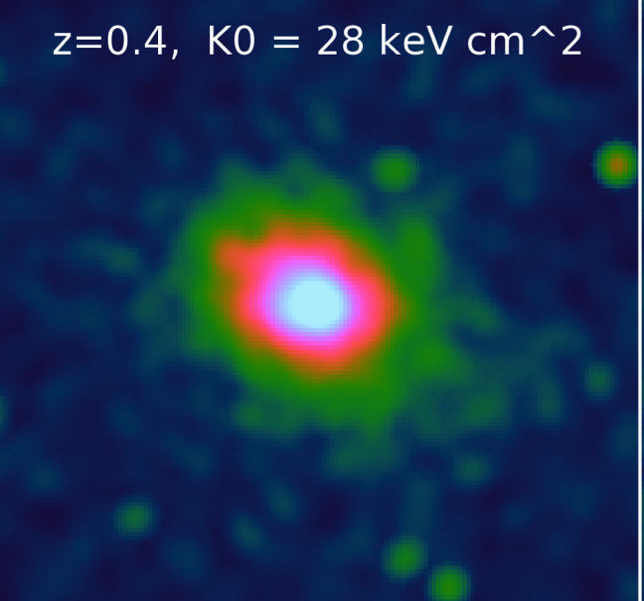
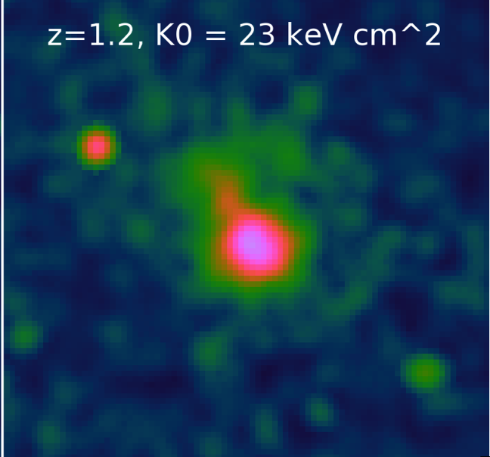
Take-Home Points
#1a. Clusters are not “cuspy” at z ~ 1.
#1b. Cool cores have not evolved in
absolute size/shape since z ~ 1
*AGN feedback is long-lived
#2. High-z clusters are
are not all mergers!
#3. Bulk of metals in ICM from z > 1.5
*Metals in core more recent
Disturbed Fraction
Z [Z]
z
z

